Slide 1
Insights of ‘UK Bank Customer’ Dataset
Created by Surya

Slide 2

So, What would be the Main Objective?
Simple , Profit!.
“More Balance more profit!”
What about Insights?
Region
Gender
Age
Job Classification
Date Joined
Let’s take a look into 5 key Points

Slide 3
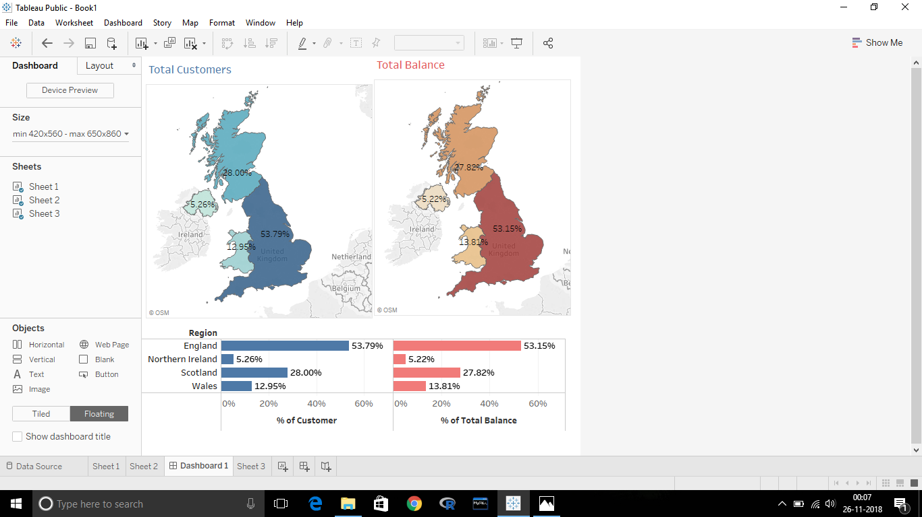
Key point 1 : Region
Need Profit?
“First Choose Region Wisely”
These Graph clearly shows Two Important things:
As the area of Region increases Total Number of Customers increases.
As the area of Region increases Total Balance also increases .
i.e. Balance is simply dependent on Region.
If we want to make more Profit , we have to choose Region wisely.
i.e. England should be first preference as it is alone generating more than 50% of Total Balance.
As the area of Northern Ireland is very small
We can hardly do anything. So N.I should be less preference.

Slide 4

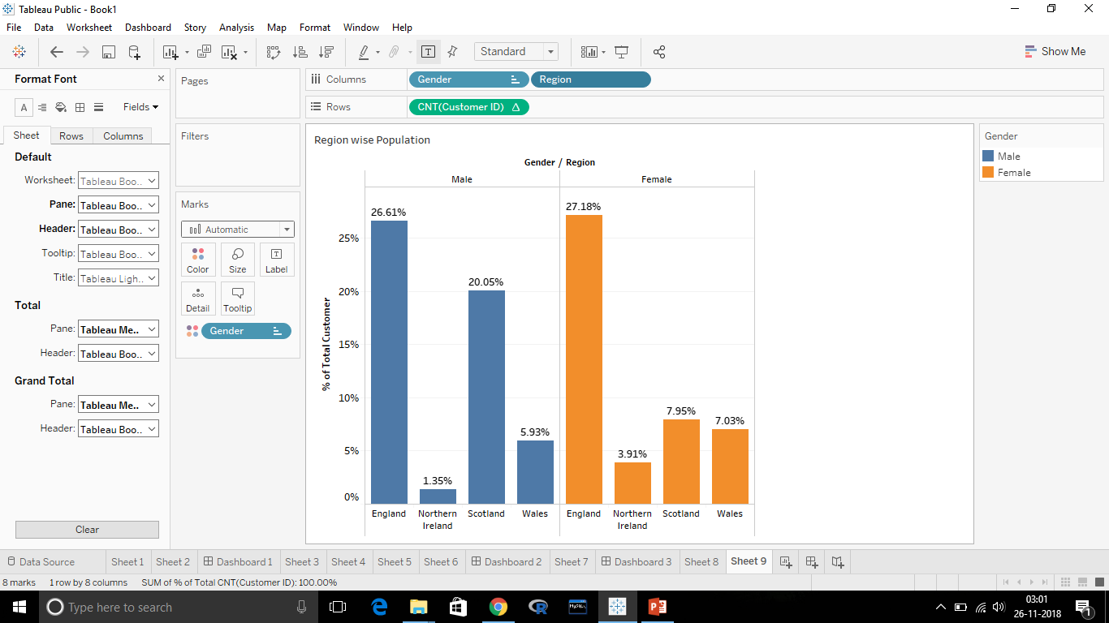
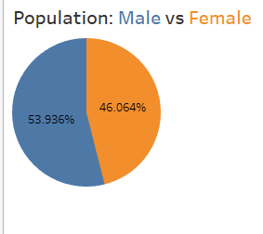
Key Point 2 : Gender
Yes. Gender is making impact on Balance.
But How?
First Reason : Population
Region wise Population : Male vs Female
Population Ratio of Male and Female is not same.
Region wise it differs.
Almost every region has more Male Customer than Female.
i.e. In Scotland the ration increase significantly very high (about 2.5 times)

Slide 5
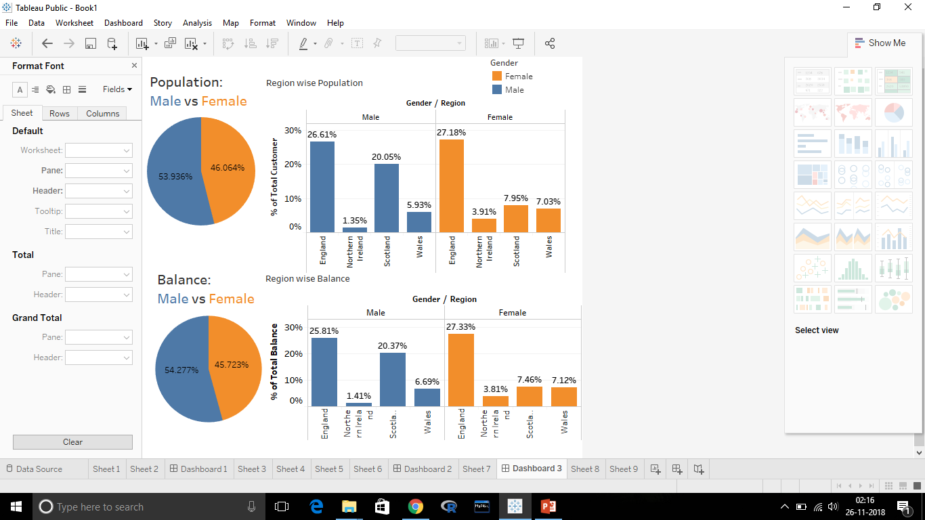
Male Customers are Contributing 9% more Profit than Female Customers Only because of different Population Ratio.

Slide 6
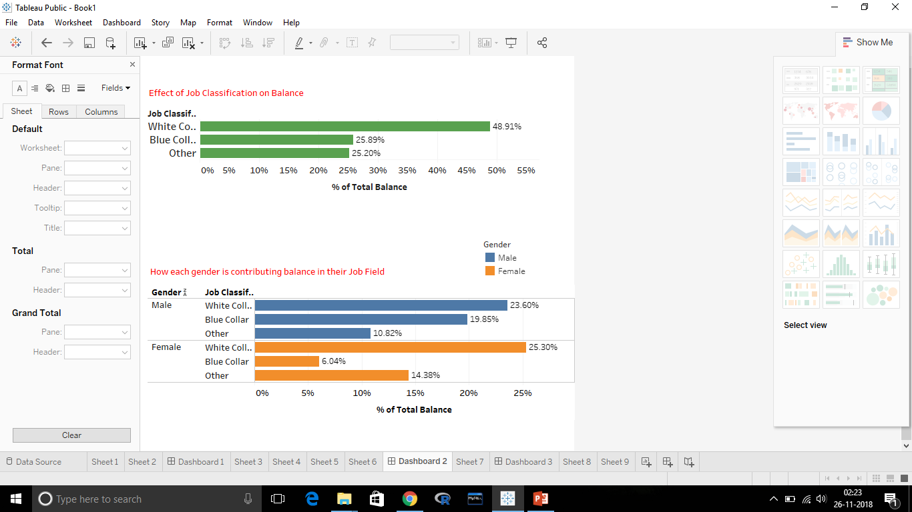
Second Reason : Job Classification
Preferring Male Customers because of Higher Population ratio can be a wrong decision.
In “White collar” and “other” , Female Customers are leading by about 6%.
But in “Blue Collar” Male Customers are about 14% more than Female Customers.
As Female Customers are high in Job Classification except one and White Collar is contributing 49% to Balance we shouldn’t preferring anyone in respect to Gender.

Slide 7
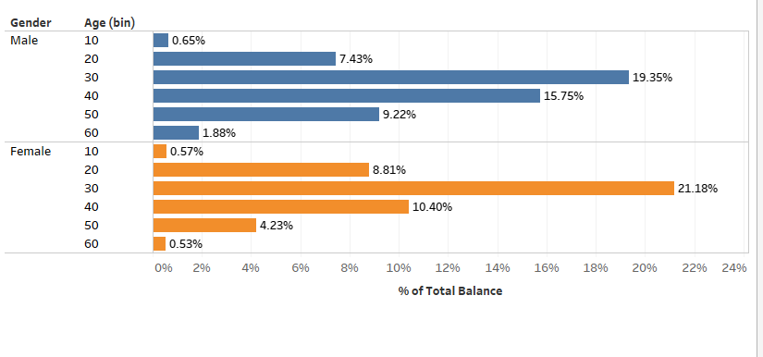
Third Reason : Age
Age group from 10 to 40 years Female Customers are Contributing more Balance than Male.
But after 40 years the scenario is been changed.
i.e. Before 40 Female Customers and after that Male Customers should be Preferred most.

Slide 8

SO , Which Gender should be Preferred?
On the basis of Population ratio we can say that Male Customers should be preferred.
On the basis of Job Classification there shouldn’t be any preference although in “Blue Collar” , there’s 14% difference between Male and Female Customers.
On the basis of Age Group again there shouldn’t be any preference because the difference is not much high.

Slide 9
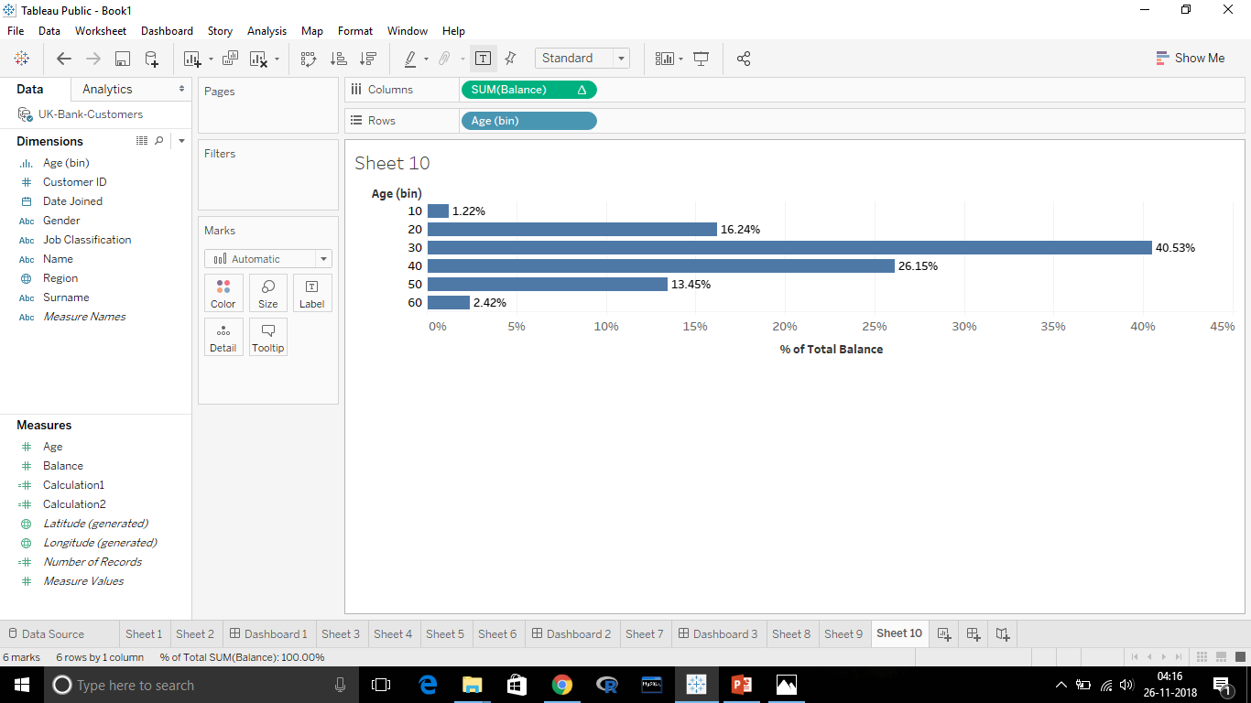
Key Point 3 : Age
Effects of Age Group on Total Balance
Before 30, Balance is increasing with Age.
After that it started decreasing.
There’s Huge increase Between 20 to 30 for about 24%.
The age group 30, is contributing 40% of total Balance.
Age group before 20 and after 50 are contributing less Balance ,approx of 3.5% of total Balance.

Slide 10
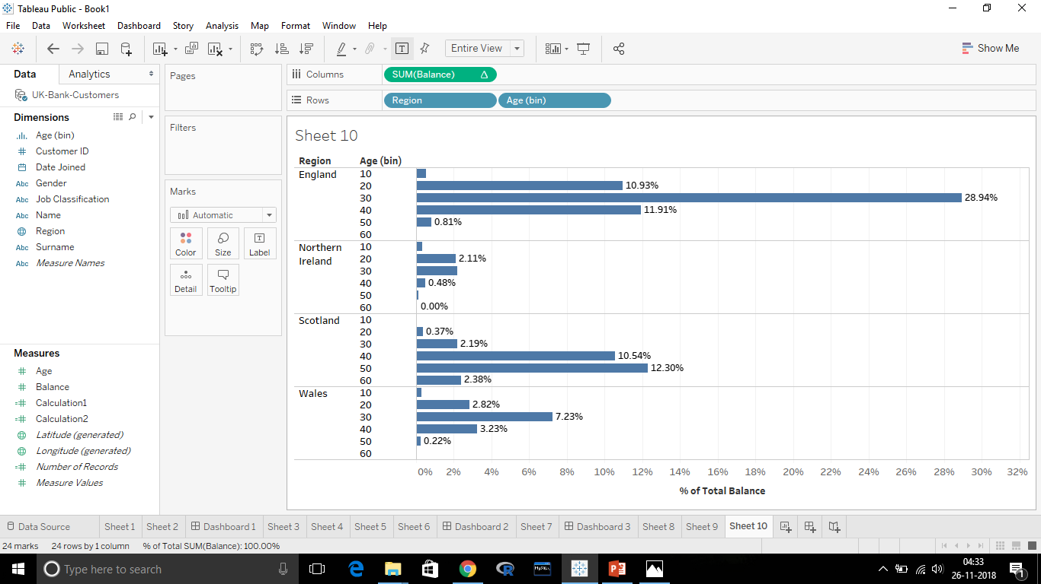
Region Wise Age Group’s Activity
This Graph shows the same,
the age group 30 is more Promising compare to other Age group
It would be more profitable if we expect from below age group of 40.
In Scotland age group more than 40 are performing well.

Slide 11
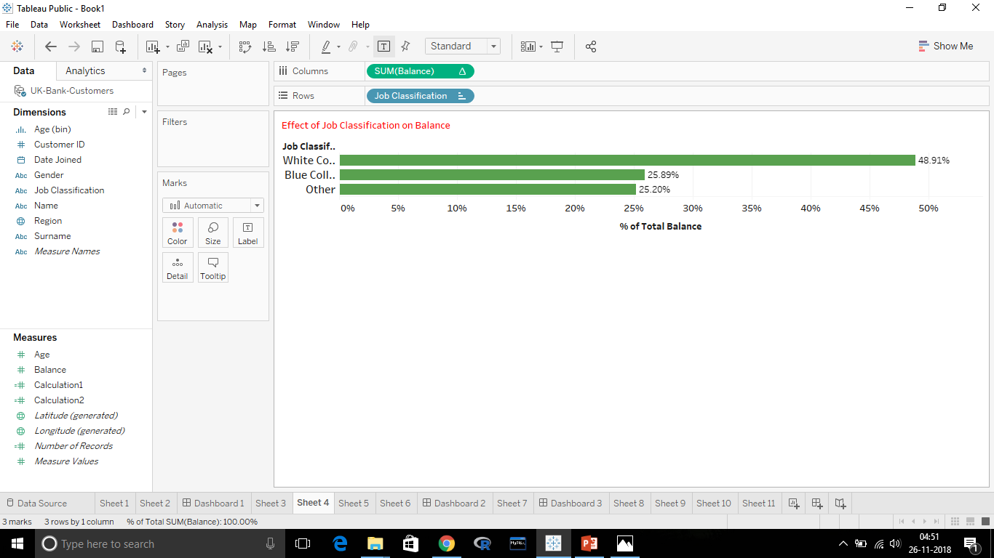
Key Point 4: Job Classification
As we can see, White Collar along Contributing 49% of Total Balance while Blue Collar and Other together contributing 51% of Total Balance.
White Collar Customers should be more preferable.

Slide 12
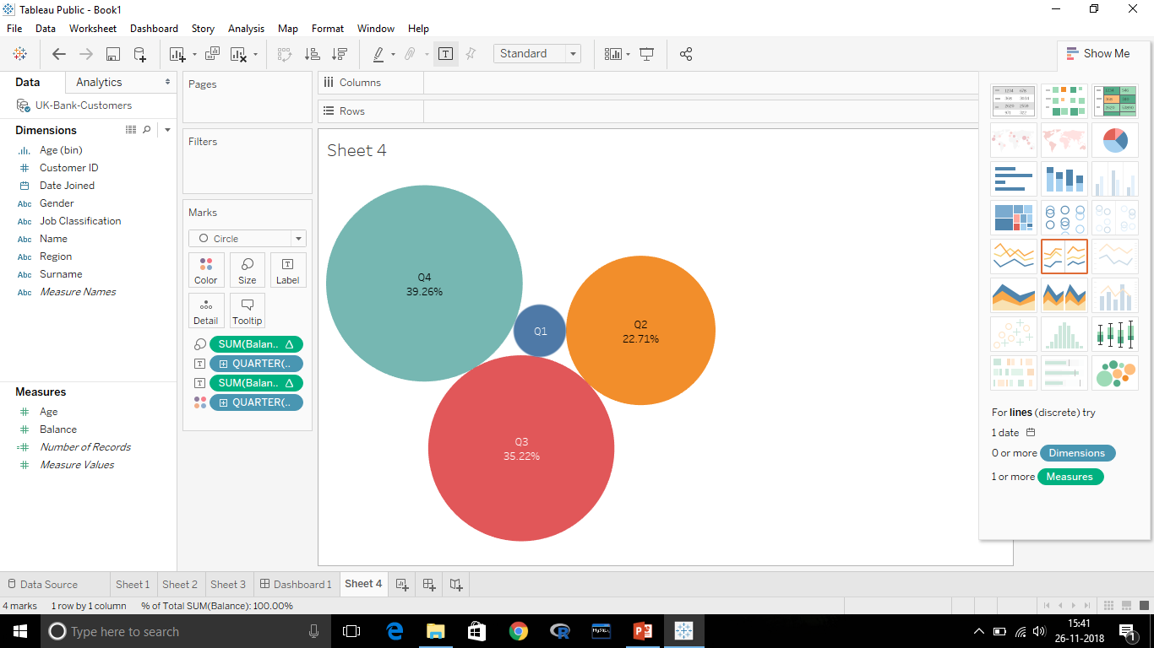
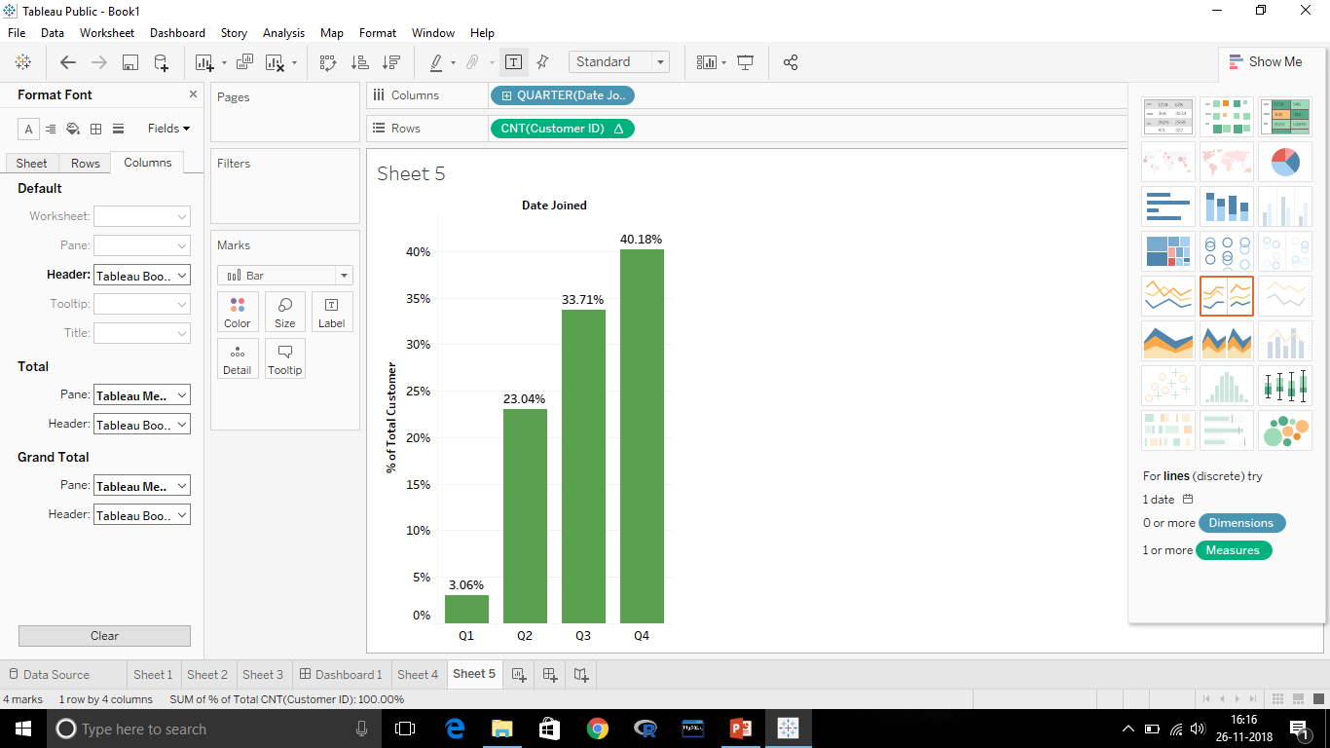
Key Point 5 : Date of Joining
Quarter wise Balance
Clearly Shows us as the Quarter Increases Balance is also increases.
Q4 is contributing about 40% whereas Q1 is only 3% of Total Balance.
But why it is
Increasing?
Number of Customers are increasing in each Quarter.
Quarter wise no. of Customers

Slide 13
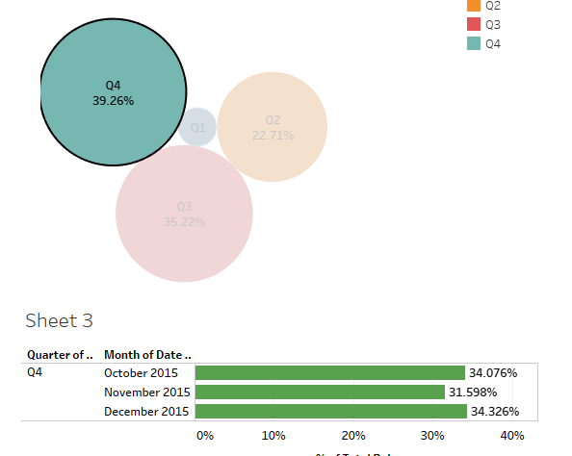
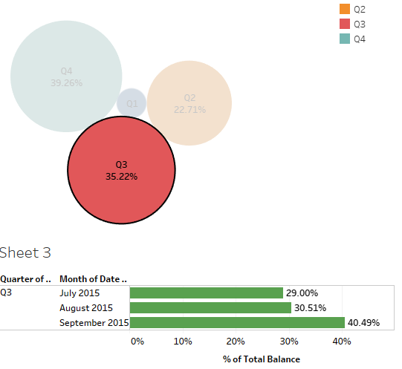
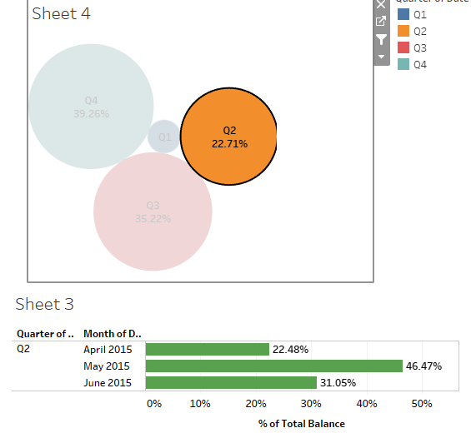
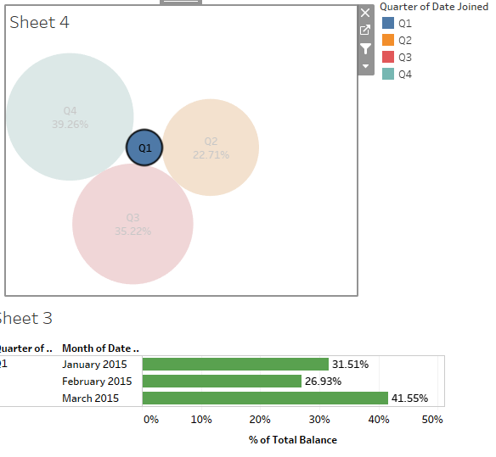
Which Month to select?
Q4
Q3
Can’t be said
No Such Pattern in Months
Q2
Q1
Month wise Balance in different Quarter.

Slide 14
What Date of Joining actually Significant?
Date of Joining actually adding no value to Balance.
As the time passes more Customers are Increasing.
That’s why quarter wise balance is increasing.
This can be estimated that next year Balance will increase as more customers will join.
There’s no Pattern in Months. So nothing can be said by predicting one year data.

Slide 15

Still Confusion making a Good Decision ?
Take a look Then:

Slide 16
Region
England
(53.15%)
Scotland
(27.82%)
Wales
(13.81%)
N. Ireland
(5.22%)
Note:
Red significant best Profit Possible
Gender
All percentage are in respect to Total Balance
Male
(54%)
Female
(46%)
Job Classification
Age Group
Job Classification
Age Group
<40
43.18%
>40
11.1%
<40
40.96%
>40
4.76%
White Collar
(23.6)
Blue Collar
(19.85)
Other
(10.82)
White Collar
(25.30)
Blue Collar
(6.04)
Other
(14.38)

